Slide 1


Q|Folio〉
Financial portfolio Optimization using QML
Project 22 (Group 2 +4): Final Presentation
August 22, 2021

Slide 2
Outline
Team & Contribution
Introduction
Project overview
Implementation Methodology
Results & Comparative Analysis
Conclusion

Slide 3
Team & Contribution
Member | Contribution
Anuj Mehrotra | Quantum & Classical ML Coding, Documentation
Mert Kasif Ceylan | Non-Machine Learning Optimization, Documentation & Classical ML Coding
Amaury de Miguel | Quantum & Classical ML Coding, Documentation
Abhinav M Hari | Classical ML Coding & Documentation
Manvi Gusain | Classical ML Coding & Documentation
Sphoorthy Nadimpalli | Quantum ML Documentation
Ege Bozdemir | Classical ML Coding & Documentation
Mentor: Aurthur Vimalachandran Thomas Jayachandran (Samara Aerospace University)

Slide 4
Introduction: Motivation
Financial Systems are complex, strongly correlated and difficult to predict, full of optimization problems, Monte Carlo sampling, stochastic differential equations, machine learning...
Quantum Mechanics principles native to Quantum Computing, make it suitable for implementing financial systems, also inline with business objectives, as reduced execution time due to Quantum Advantage can also ensure more savings.

Slide 5
Problem Mapping
Problem | High Level Solution
Which assets should be included in an optimized portfolio, and how should one change its composition according to the market? | Classical: Optimization models Quantum optimization Quantum-Inspired Optimization
How to detect opportunities in the different assets in the market, and take profit by trading them? | Classical: Machine learning Quantum machine learning
How to estimate the risk of a portfolio, a company, or even the whole financial system? | Classical: Monte Carlo Quantum amplitude estimation Quantum Monte Carlo

Slide 6
Introduction: Portfolio Optimization
Financial portfolio optimization is the problem of optimal allocation of a fixed budget to a collection of assets (commodities, bonds, securities etc.) which produces random returns over time.
Portfolio Optimization
Goals:
• Maximize returns
• Minimize risk
• Stay within budget
Output:
• A portfolio representing a list of investments and the expected return
Inputs:
• Uniform random historical price data
• Budget
• Risk tolerance

Slide 7
Project Overview
Goal : Implement quantum algorithms for optimization financial portfolio. To reduce errors and improve accuracy for computing expected returns from assets.
Background : Combinatorial optimization problem is a class of problems where goal is to find the best solution from a finite set of solutions.
Approach: CVaR (Conditional Value-at-Risk) adaption to QAOA (Quantum approximate optimization algorithm) is good for combinatorial optimization though it is a special case of VQE (Variational-Quantum-Eigensolver ).
Why not VQE : In VQE goal is to find the ground state energy and in order to do that ground state need to be need reproduced. While in QAOA goal is to find the solution to the problem. To do that there is no need to find the ground state — just need to find a state which has a high enough probability of finding the right solution aligned to requirement of combinatorial optimization problem .
What is the special about this Approach : CVaR (Conditional Value-at-Risk) is an aggregation function which leads to faster convergence to better solutions for all combinatorial optimization problems.

Slide 8





Project Overview : Considerations
During implementation of Quantum portfolio optimizer framework, intent was to also highlight comparative features , to achieve same and keep approach within Quantum Computing Simulator limits, a portfolio of 5 assets from US Stock Exchange was considered ( based on lesser correlation) .
Input portfolio dataset was generated using Yahoo finance historical (2015 – 2020) trading data for 5 stocks :
IBM (IT Industry)
Pfizer (Healthcare / Pharmacy)
Exxon Mobil Corp. (Oil & Gas )
Bank of America (Finance / Banking)
Tesla (Automobile / Technology)

Slide 9
Technology Ecosystem for Methodologies Comparison
Non-Machine Learning :
Tool (s): MS Excel
Solver / Optimizer : GRG (Generalized Reduced Gradient) Nonlinear
Platform : Windows 10
Classical Machine Learning:
Programming Language : Python 3.x >= 3.7
ML Library : Keras (2.4) for Neural Network, Pandas, Numpy, Yahoo Finance , Scikit Learn, SciPy
Neural Network Type : Long Short-Term Memory (LSTM)
Platform : Jupyter Notebook on Google Colab / Kaggle (with GPU access)
Quantum Machine Learning:
Programming Language : Python 3.x >= 3.7
Quantum Programing SDK : Qiskit (latest >=0.29)
Algorithm : CVaR + QAOA
Platform : Qiskit QASM Simulator

Slide 10
Implementation Methodology

Slide 11

Quantum Framework
Portfolio Expected Return
The expected return of a portfolio is calculated by multiplying the weight of the asset by its return and summing the values of all the assets together. To introduce a forward looking estimate, probability may be introduced to generate and incorporate features in business and economy.
Portfolio Optimization Concepts

Slide 12

Quantum Framework
Portfolio Variance
Portfolio variance is used as the measure of risk in this model. A higher variance will indicate a higher risk for the asset class and the portfolio. The formula is expressed as
Portfolio Optimization Concepts

Slide 13

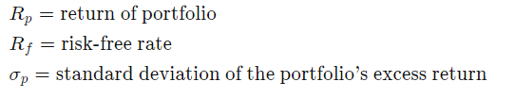
Quantum Framework
Sharpe Ratio
The Sharpe ratio measures the return of an investment in relation to the risk-free rate (Treasury rate) and its risk profile. In general, a higher value for the Sharpe ratio indicates a better and more lucrative investment. Thus, if comparing two portfolios with similar risk profiles, given all else equal, it would be better to invest in the portfolio with a higher Sharpe Ratio.
Portfolio Optimization Concepts

Slide 14
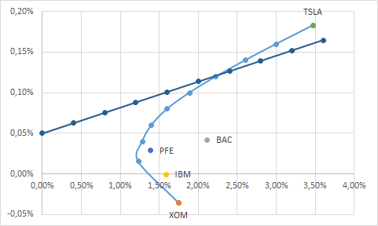
Non Machine-Learning Results
 | XOM | BAC | IBM | PFE | TSLA
Expected Return | -0.04% | 0.04% | 0.00% | 0.03% | 0.18%
Variance | 0.03% | 0.04% | 0.03% | 0.02% | 0.12%
Std.Dev. | 1.75% | 2.11% | 1.59% | 1.39% | 3.47%
 | XOM | BAC | IBM | PFE | TSLA | Weights
XOM | 0.030% | 0.024% | 0.016% | 0.010% | 0.015% | 0.0%
BAC | 0.024% | 0.044% | 0.020% | 0.013% | 0.021% | 11.9%
IBM | 0.016% | 0.020% | 0.025% | 0.011% | 0.015% | 0.0%
PFE | 0.010% | 0.013% | 0.011% | 0.019% | 0.009% | 28.1%
TSLA | 0.015% | 0.021% | 0.015% | 0.009% | 0.120% | 60.0%
 |  |  |  |  | SUM | 100%
Portfolio Return | 0.12%
Portfolio Risk | 0.05%
Portfolio Std Dev | 2.29%
Risk Free Rate | 0.05%
Sharpe Ratio | 0.032

Slide 15
Quantum Framework
Long short-term memory (LSTM) is an artificial recurrent neural network (RNN) architecture used in the field of deep learning. Unlike standard feedforward neural networks, LSTM has feedback connections. It can process not only single data points (such as images), but also entire sequences of data (such as speech or video).
To simulate Classical ML code LSTM- Long Short-Term Memory model was used with 4 layers (LSTM +Dense) of 800 neurons was used to forecast the trend of the assets for next 22 days with 60 days of feedback loop.
Scaled the data using MinmaxScaler as LSTM is sensitive non stationary component
PCA (Principal Component Analysis) was used to retrieve principal components to keep most of the useful features dataset.
Prediction results from LSTM was used to optimize the portfolio using optimizer of SciPy library
Optimized weights for portfolio were based on Optimized Sharpe Ratio as an input, the negative of sharpe ratio was minimized with the help of SciPy optimizer.
Classical Machine-Learning (LSTM +PCA + SCIPY) Overview

Slide 16
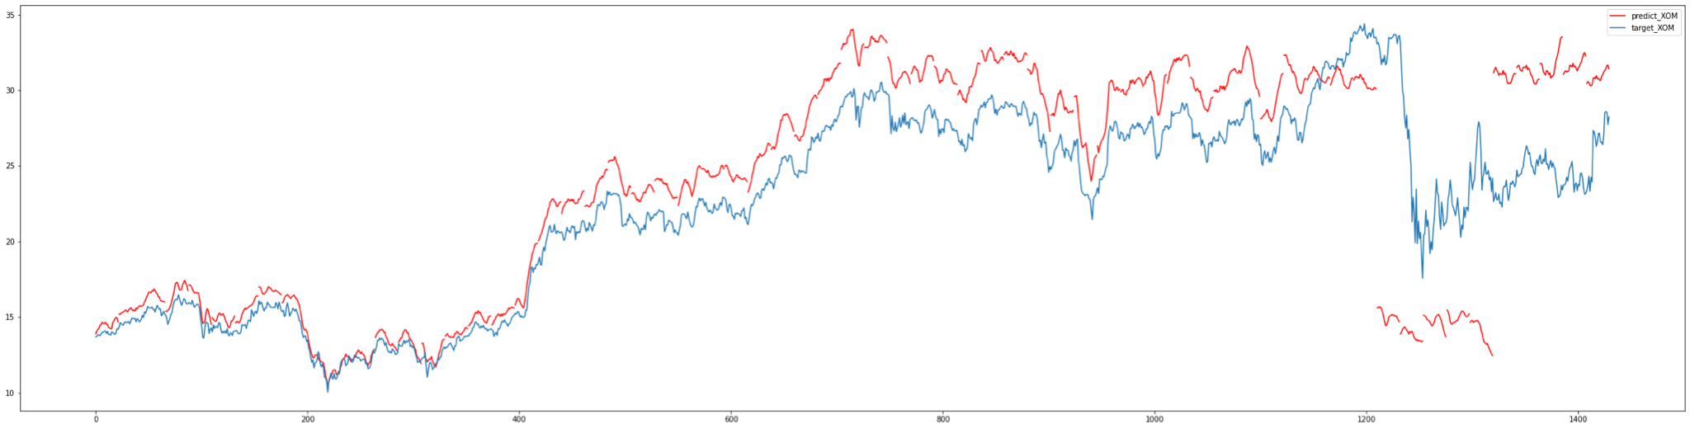
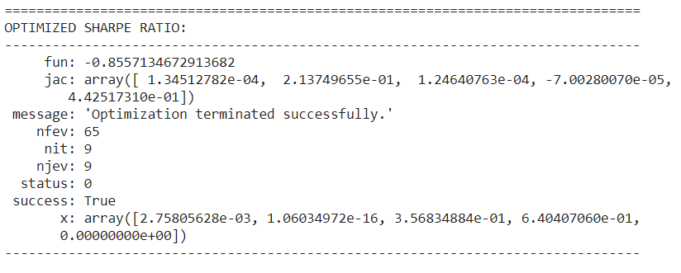
Classical Machine-Learning Results
LSTM Prediction Accuracy on complete Dataset
Optimized Portfolio Weights for optimized sharpe ratio
Bank of America: 0.003
IBM: 0
Pfizer: 0.357
Tesla: 0.640
Exxon: 0
Final sharpe ratio of 0.86 compared to 0.20 using optimized volatility

Slide 17
QAOA Overview
QAOA (Quantum Approximate Optimization Algorithm) introduced by Farhi et al. is a quantum algorithm that attempts to solve such combinatorial problems.
It is a variational algorithm that uses a unitary U(β,γ) characterized by the parameters (β,γ) to prepare a quantum state |ψ(β,γ⟩. The goal of the algorithm is to find optimal parameters (β_{opt,}γ_{opt}) such that the quantum state |ψ(β_{opt,}γ_{opt)}⟩ encodes the solution to the problem.
The unitary U(β,γ) has a specific form and is composed of two unitaries U(β)=e^{−iβB} and U(γ)=e^{−iγHP} , where B is the mixing Hamiltonian and H_{P} is the problem Hamiltonian. Such a choice of unitary drives its inspiration from a related scheme called quantum annealing.

Slide 18
QAOA : Role of Mixer
H_{P} is a diagonal Hamiltonian in Z basis and without mixing Hamiltonian, from a physical point, the system evolves under closed-system dynamics and the energy (represented here by H_{p}) is conserved, which means energy (that is, in "cost") by choosing different values of γ (Gamma).
All of this changes, if a mixer is applied (where e.g.B=∑iσi^{x} ) U(β)≡exp⁡(−iβB) to state |ψ(γ)⟩ so that:
|ψ(γ,β)⟩≡exp⁡(−iβB)exp⁡(−iγH_{p})|ψ⟩
Since H_{p} and B do not commute, the dynamics generated by B will not in general conserve the "energy" (i.e. the cost) H_{p}.Now the (correct) QAOA energy functional
f(γ,β)=⟨ψ(γ,β)|HC|ψ(γ,β)⟩
is no longer a constant function of γ,β and classical optimizer can be to minimize its value. That is in general values γ∗,β∗ can be found such that
⟨ψ(γ∗,β∗)|Hp|ψ(γ∗,β∗)⟩<⟨ψ|Hp|ψ⟩.
The exact same argument applies to any depth p of the QAOA variational Ansatz.

Slide 19

Conditional Value at Risk (CVaR)
The idea behind calculating the Conditional Value at Risk (or CVaR) is an adaptation to QAOA .
Instead of calculating the mean of all cut values c_{i} obtained from the measurement outcomes of the circuit to compute the cost function f, the algorithm only takes into account a fraction α of the highest measured cut values.
,
where the c_{i} are ordered decreasing in size. Since interest is in obtaining a single good solution for the original optimization problem, looking only at a fraction of the best cuts can help to speed up the optimization process.

Slide 20

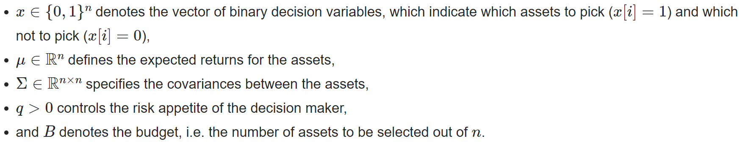
Quantum Framework
Using the Quantum Approximation Optimization Algorithm
Goal to minimize the following function
Quantum Machine-Learning (QAOA) for Portfolio Optimization

Slide 21
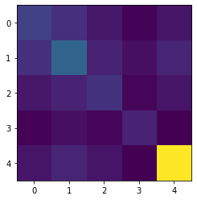
Quantum Machine-Learning Results
Initial Stocks ['XOM’(0), 'BAC’(1), 'IBM'(2), 'PFE'(3), 'TSLA’(4)]
Minimum Variance For Optimal Portfolio Selection:
Using Classical EigenSolver
['BAC', 'TSLA']
Using QAOA without Conditional Value At Risk
[‘XOM', 'TSLA']
Using QAOA with Conditional Value At Risk (alpha= 0.05)
['XOM', 'BAC', 'IBM', 'PFE’]
Covariance matrix for the assets
Covariance Plot

Slide 22
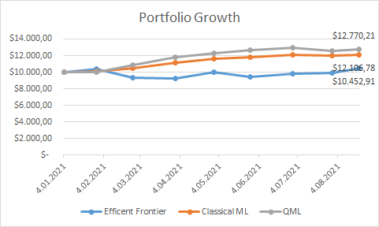
Current Trends:
Efficient Frontier Theory
Comparative Analysis

Slide 23
References
Markowitz Portfolio Optimization with a Quantum Anneale: Erica Grant, Travis Humble , University of Tennessee https://www.dwavesys.com/sites/default/files/5_Grant_Erica_ORNL.pdf
Improving Variational Quantum Optimization using CVaR – https://arxiv.org/abs/1907.04769
Quantum computing for finance: overview and prospects https://arxiv.org/abs/1807.03890
Qiskit Textbook

Slide 24
Conclusion
Classical ML can leverage Tensor Networks which highly improvable (GPUs, etc)
VQE & QAOA (in NISQ) highly limited by underlying hardware advancements, though somewhat resistant to noise
CVaR (Conditional Value-at-Risk) is an aggregation function which leads to faster convergence to better solutions for all combinatorial optimization problems.
Largest portfolio optimization so far possible
with quantum and Tensor Network methods and with real data.
Improvable, promising

Slide 25
Thank You for Attention !

